Slide 1
Post Correspondence Problem
Simon Schrodi
DHBW Karlsruhe
12.04.2019

Slide 2
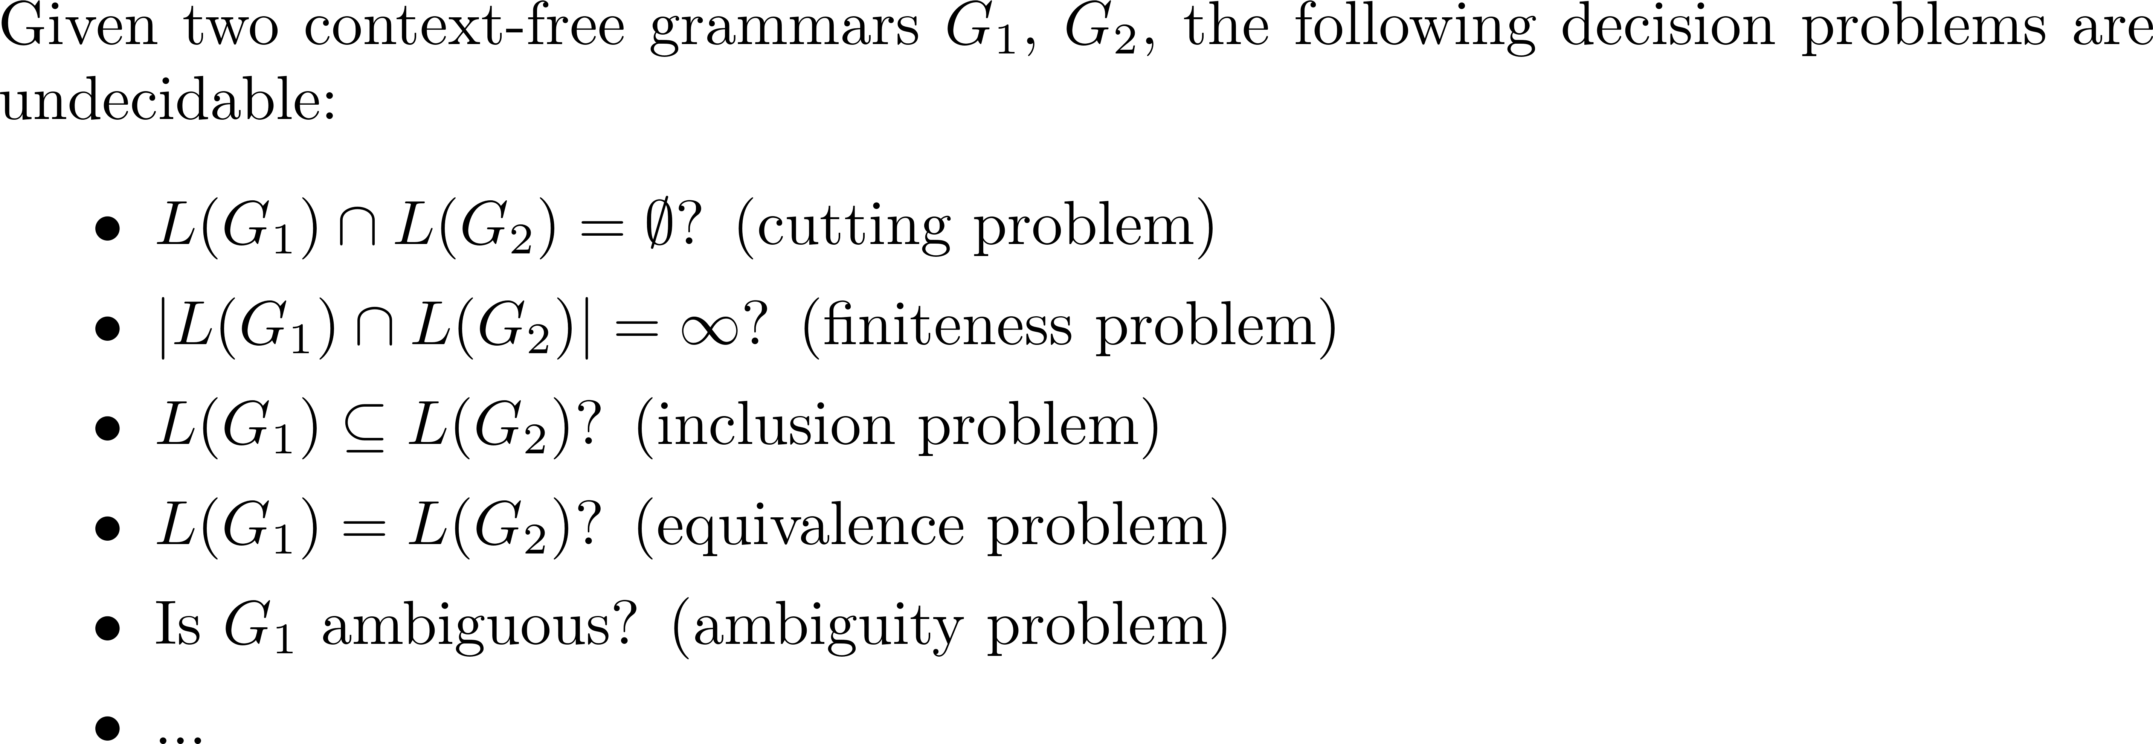
Motivation

Slide 3
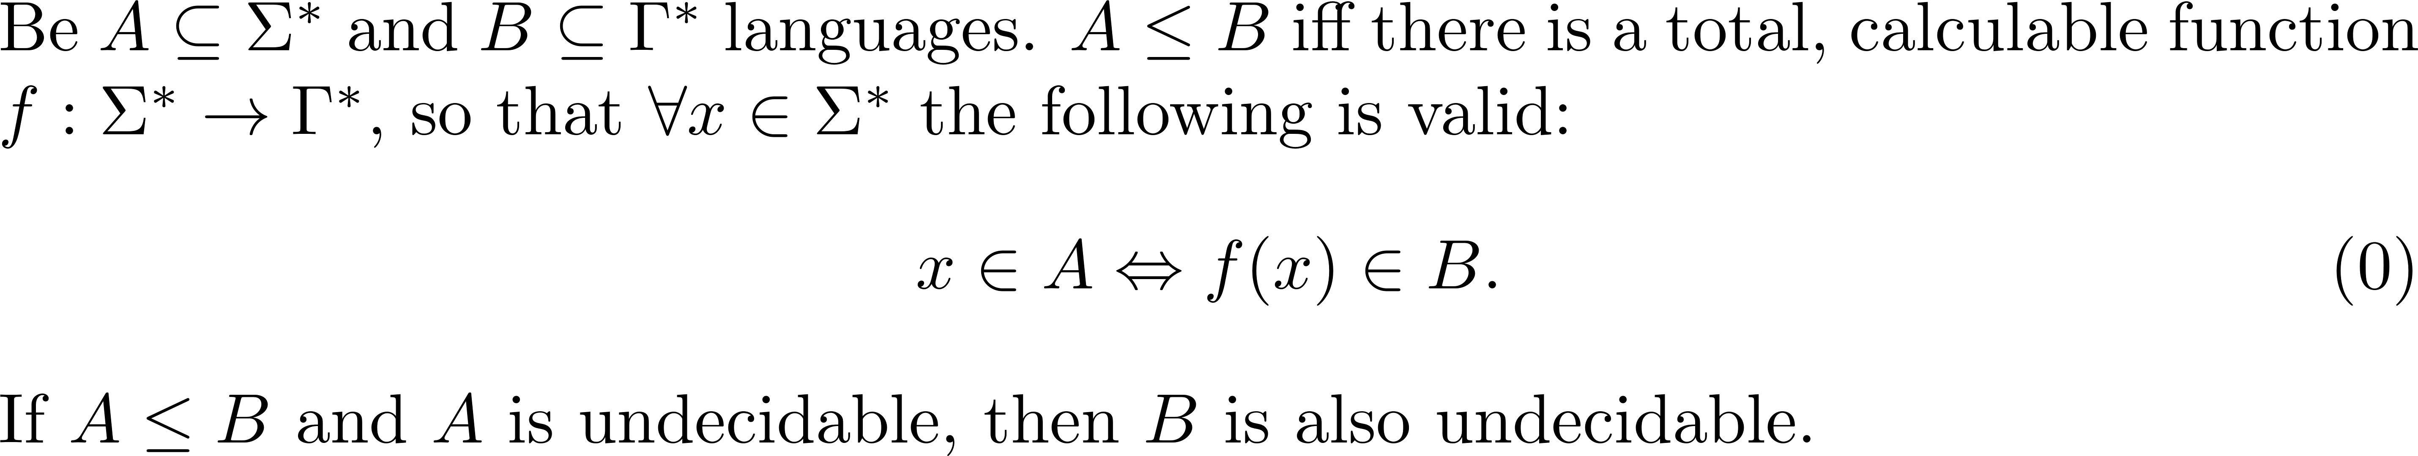
Repitition: Reduction theorem

Slide 4
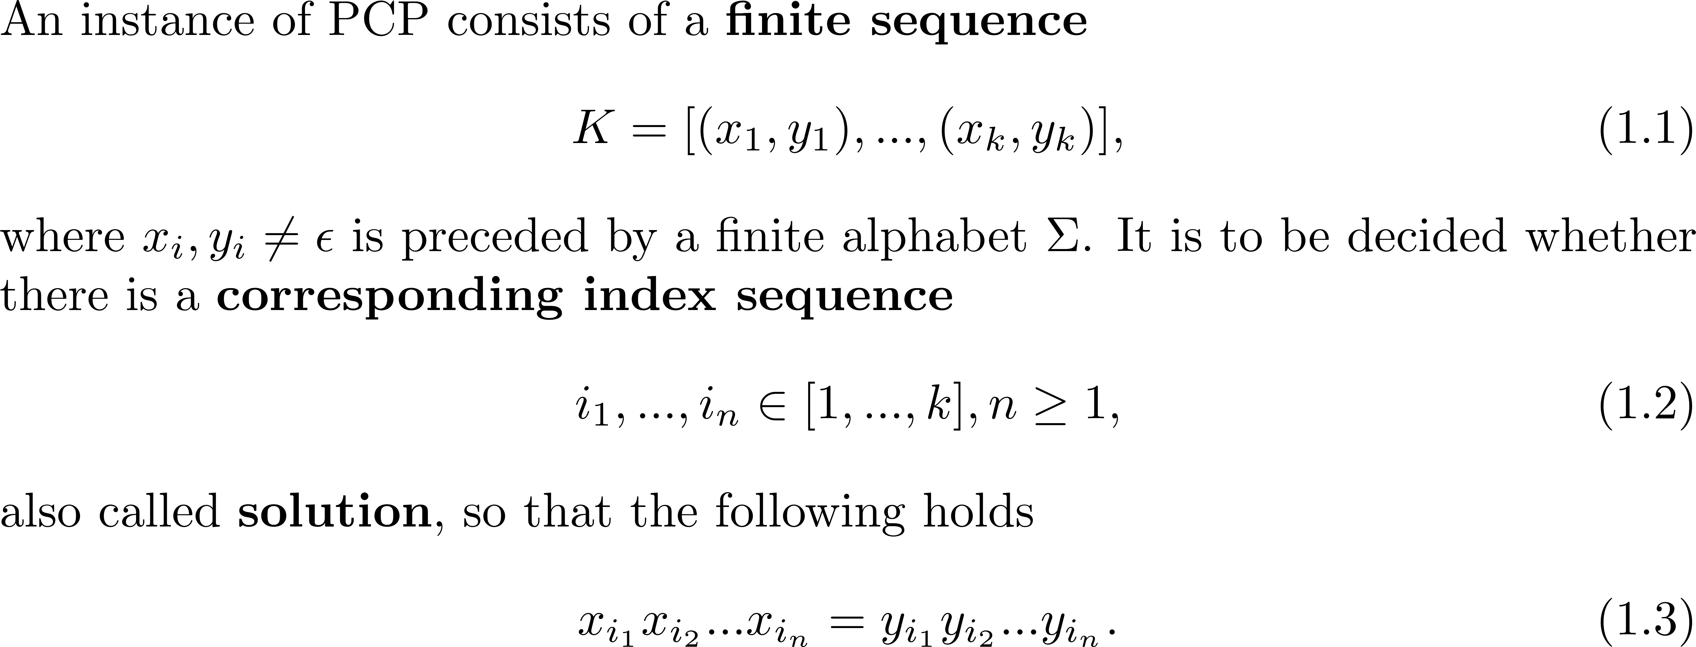
Definition: Post Correspondence Problem (PCP)

Slide 5
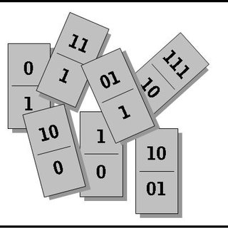
Definition: Modified PCP (MPCP)
Image source:: https://www.researchgate.net/profile/Klaus_Jantke/publication/297212574/figure/fig2/AS:337034053996545@1457366588223/Abbildung-23-Unloesbare-Problemstellung-Dass-es-fuer-den-Pool-von-Wortpaaren-in-der-Abb_Q320.jpg
Same as PCP with the additional condition $i_{1}=1$

Slide 6

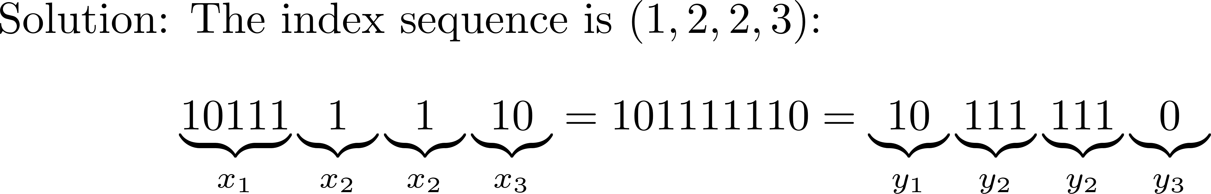
Example PCP 1

Slide 7
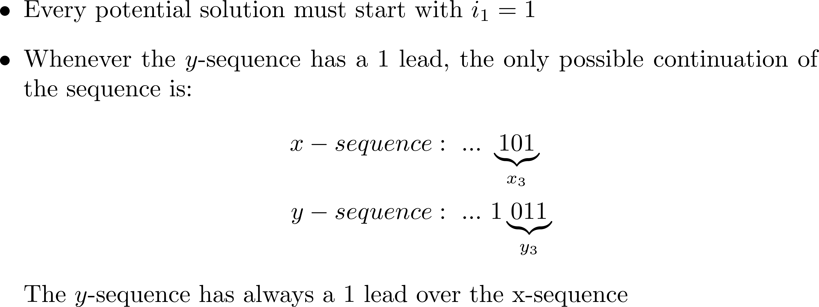
Example PCP 2

Slide 8
Beispiel PKP 3
Notes:
Ok noch ein letztes Beispiel. Diesmal mit Lösung
Wie wir sehen, ist dieses scheinbar einfache Problem, gar nicht so einfach lösbar

Slide 9
Theorem: MPCP is semi-decidable
Combinatorial decision tree
Depth search or breadth search?

Slide 10
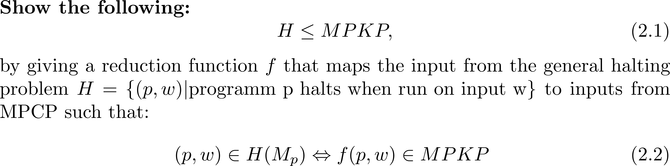
Auxiliary theorem: MPCP is undecidable

Slide 11



Configuration of a Turing machine $M_{w}$
z
••• ⎕ | $$α$$ | $$b$$ | $$β$$ | ⎕ •••

Slide 12
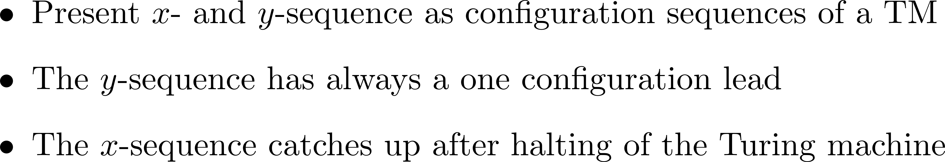
Idea of proof
Notes:
Ok, endlich mit Beweis beginnen

Slide 13
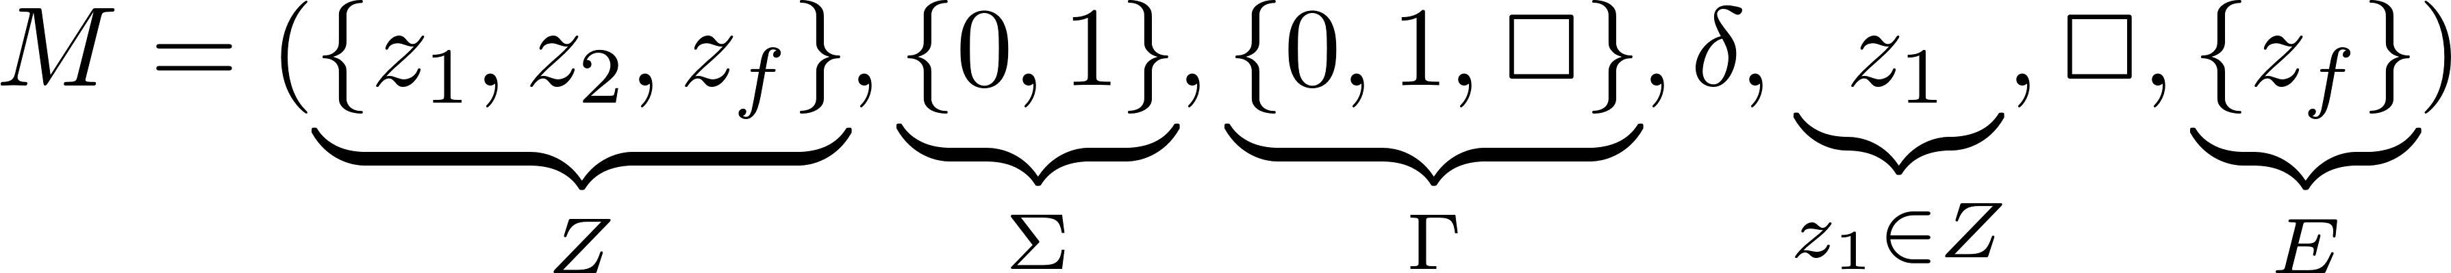
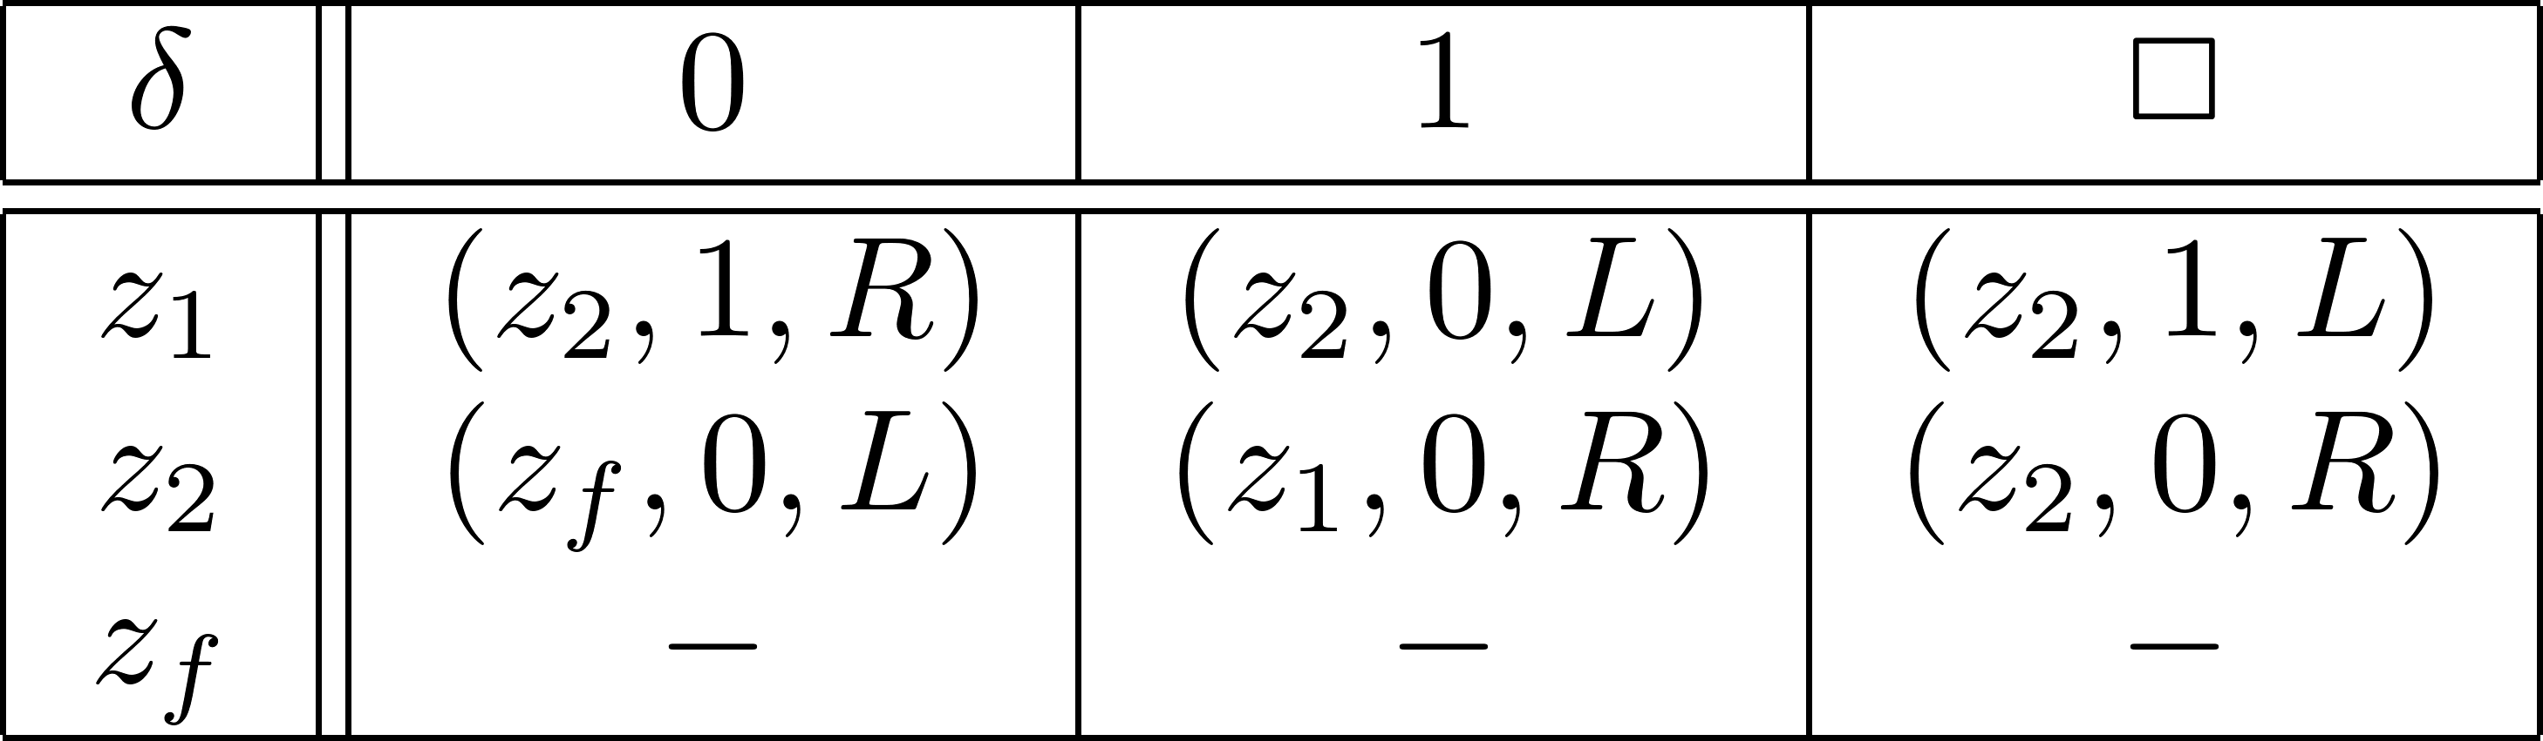
Exemplary Simulation

Slide 14
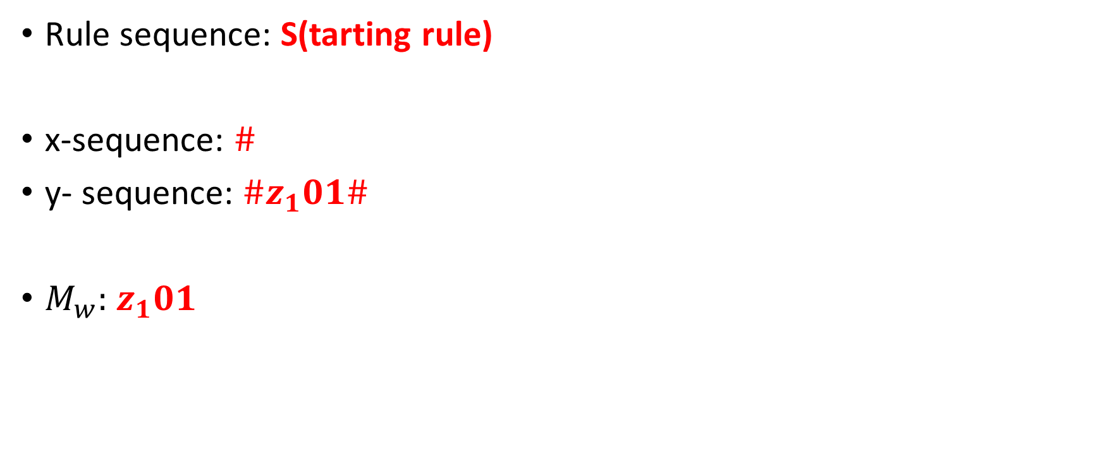
Exemplary Simulation: Solution 1
x- und y-sequence as configuration sequence
Rule sequence: S(tarting rule)
x-sequence: $\#$
y- sequence: $\#z_{1}01\#$
$M_{w}:$ $z_{1}01$
y-sequence has always a one configuration lead
Notes:
Turingmaschine darstellen
Ideen wiederholen
Konfiguration erinnern -> in Rauten einrahmen
Anfangsregel: ($\#,\#z_{1}w$#)
Warum Raute in x-Sequenz -> nicht-leere Wörter

Slide 15
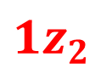
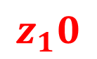
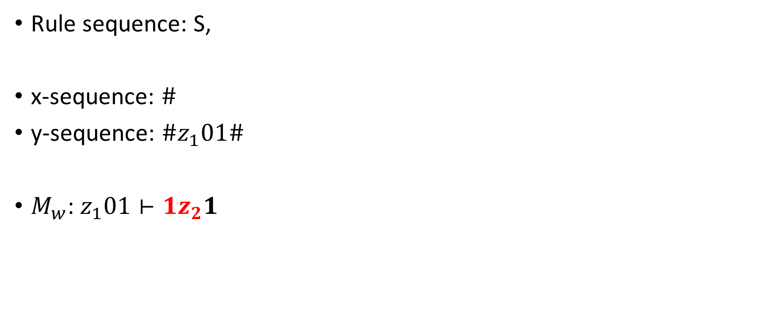
Exemplary Simulation: Solution 2
(R)ight-transfer rule
Rule sequence: S,
x-sequence: $\#$
y-sequence: $\#z_{1}01\#$
$M_{w}\text{: }z_{1}01⊢1z_{2}1$
$$z_{1}0$$
y-sequence has always a one configuration lead
$$1z_{2}$$

Slide 16


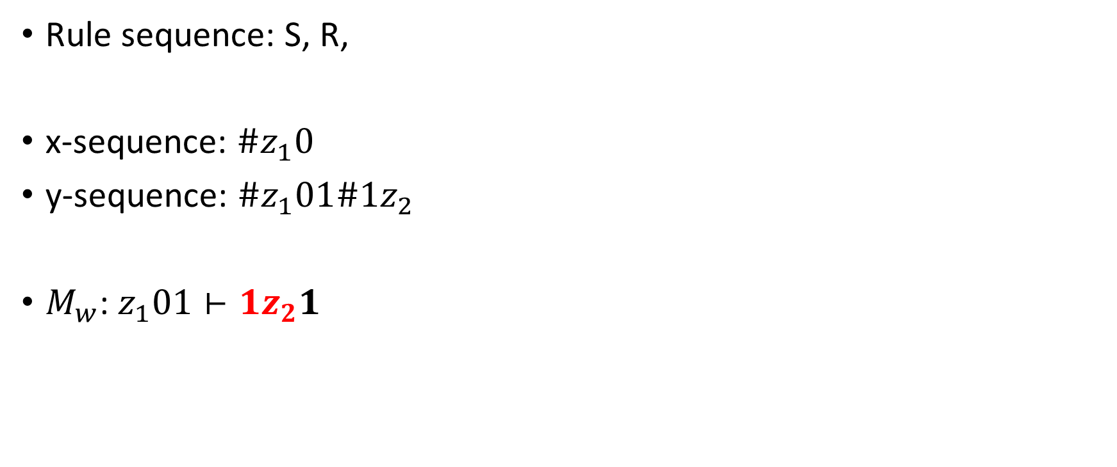
Exemplary Simulation: Solution 3
(C)opy rule
Rule sequence: S, R,
x-sequence: $\#z_{1}0$
y-sequence: $\#z_{1}01\#1z_{2}$
$M_{w}\text{: }z_{1}01⊢1z_{2}1$
$$1$$
y-sequence has always a one configuration lead
$$1$$

Slide 17

Exemplary Simulation: Solution 4
C
Rule sequence: S, R, C,
x-sequence: $\#z_{1}01$
y-sequence: $\#z_{1}01\#1z_{2}1$
$M_{w}\text{: }z_{1}01⊢1z_{2}1$
#
y-sequence has always a one configuration lead
#

Slide 18
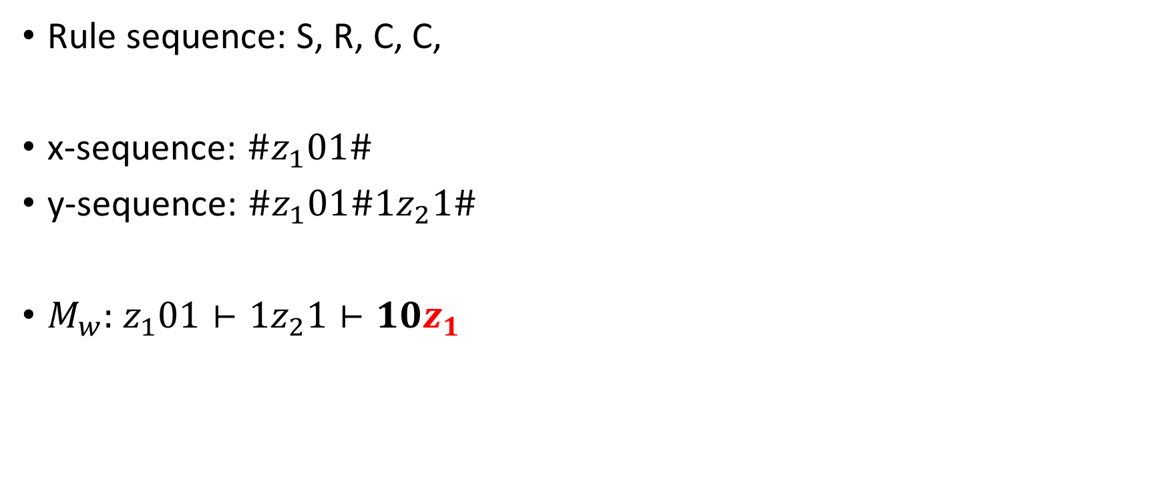
Exemplary Simulation: Solution 5
C
Rule sequence: S, R, C, C,
x-sequence: $\#z_{1}01\#$
y-sequence: $\#z_{1}01\#1z_{2}1\#$
$M_{w}:$ $z_{1}01⊢1z_{2}1⊢10z_{1}$
1
y-sequence has always a one configuration lead
1

Slide 19

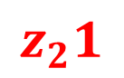
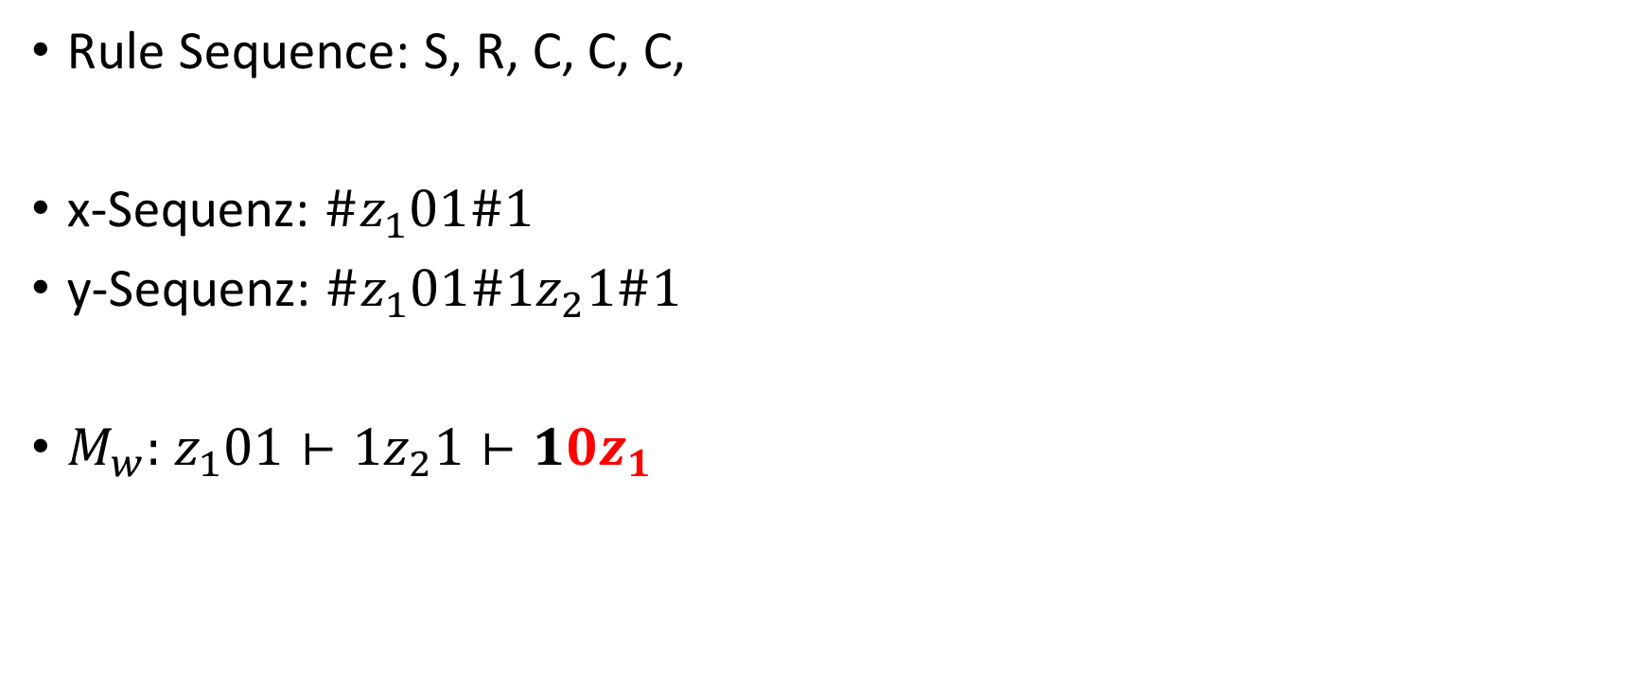
Exemplary Simulation: Solution 6
R
Rule Sequence: S, R, C, C, C,
x-Sequenz: $\#z_{1}01\#1$
y-Sequenz: $\#z_{1}01\#1z_{2}1\#1$
$M_{w}:$ $z_{1}01⊢1z_{2}1⊢10z_{1}$
$$z_{2}1$$
y-sequence has always a one configuration lead
$${0z}_{1}$$

Slide 20





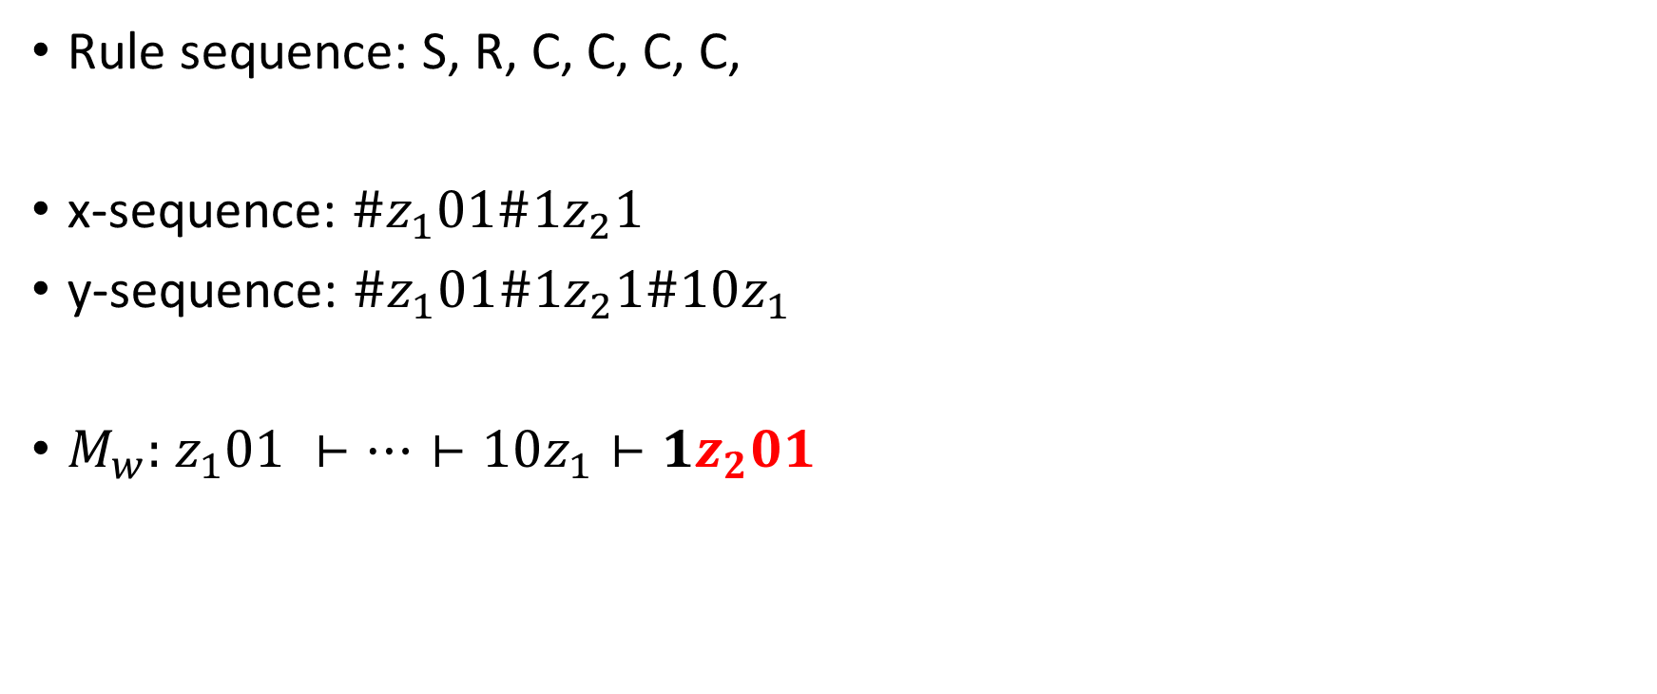
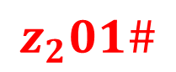
Exemplary Simulation: Solution 7
C,
C,
(S1)-special rule
Rule sequence: S, R, C, C, C, C,
x-sequence: $\#z_{1}01\#1z_{2}1$
y-sequence: $\#z_{1}01\#1z_{2}1\#10z_{1}$
$M_{w}:$ $z_{1}01 ⊢…⊢10z_{1}⊢1z_{2}01$
$$\#$$
$$1$$
$${0z}_{1}\#$$
y-sequence has always a one configuration lead
$$\#$$
$$z_{2}01\#$$
$$1$$

Slide 21


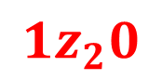


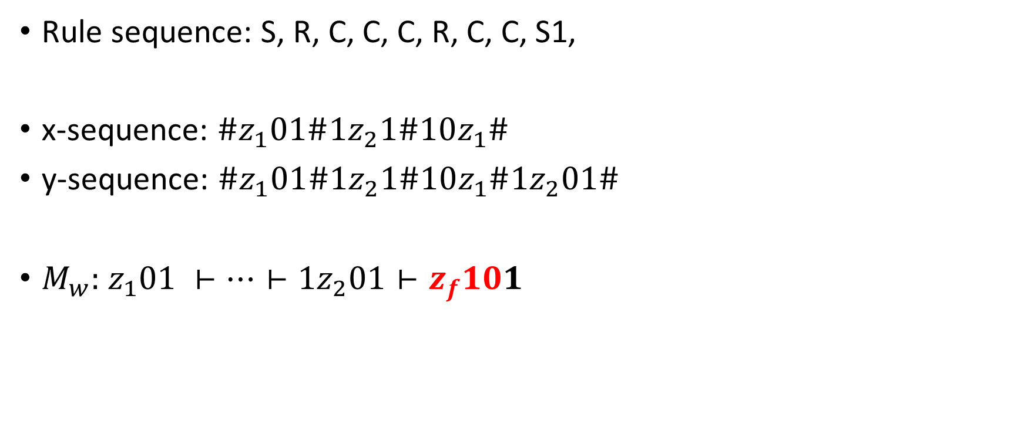

Exemplary Simulation: Solution 8
C,
C
(L)eft-transfer rule,
Rule sequence: S, R, C, C, C, R, C, C, S1,
x-sequence: $\#z_{1}01\#1z_{2}1\#10z_{1}\#$
y-sequence: $\#z_{1}01\#1z_{2}1\#10z_{1}\#1z_{2}01\#$
$M_{w}:$ $z_{1}01 ⊢…⊢1z_{2}01⊢z_{f}101$
$$1$$
$$\#$$
$${1z}_{2}0$$
$$z_{f}10$$
$$1$$
$$\#$$

Slide 22
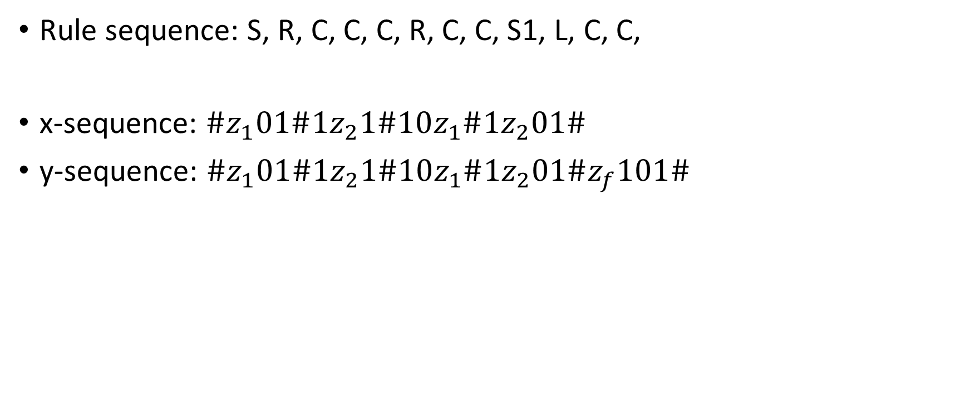

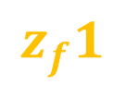
Exemplary Simulation: Solution 9
(D)eletion rule
Rule sequence: S, R, C, C, C, R, C, C, S1, L, C, C,
x-sequence: $\#z_{1}01\#1z_{2}1\#10z_{1}\#1z_{2}01\#$
y-sequence: $\#z_{1}01\#1z_{2}1\#10z_{1}\#1z_{2}01\#z_{f}101\#$
$$z_{f}1$$
$$z_{f}$$
x-sequence catches up after halting of Turing machine

Slide 23



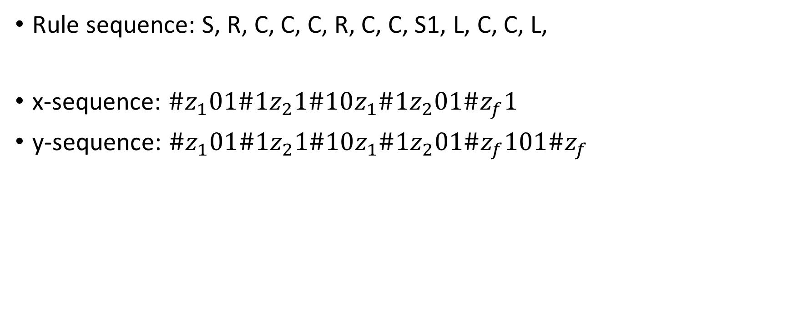

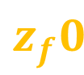
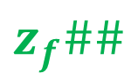







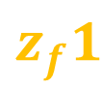




Exemplary Simulation: Solution 10
C,
C,
C,
D,
C,
C,
D,
C,
Rule sequence: S, R, C, C, C, R, C, C, S1, L, C, C, L,
x-sequence: $\#z_{1}01\#1z_{2}1\#10z_{1}\#1z_{2}01\#z_{f}1$
y-sequence: $\#z_{1}01\#1z_{2}1\#10z_{1}\#1z_{2}01\#z_{f}101\#z_{f}$
(C)losing rule
$$0$$
$$1$$
$$\#$$
$$z_{f}0$$
$$1$$
$$\#$$
$$z_{f}1$$
$$\#$$
$$z_{f}\#\#$$
$$0$$
$$1$$
$$\#$$
$$z_{f}$$
$$1$$
$$\#$$
$$z_{f}$$
$$\#$$
$$\#$$

Slide 24
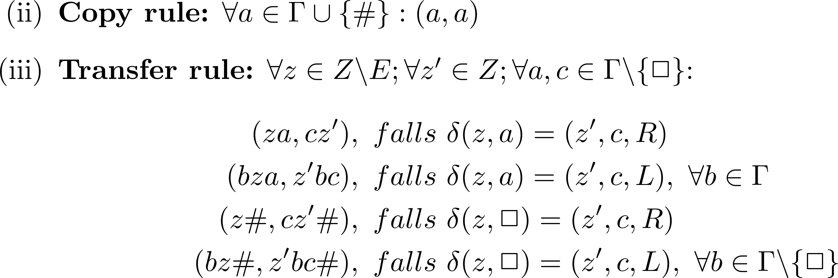
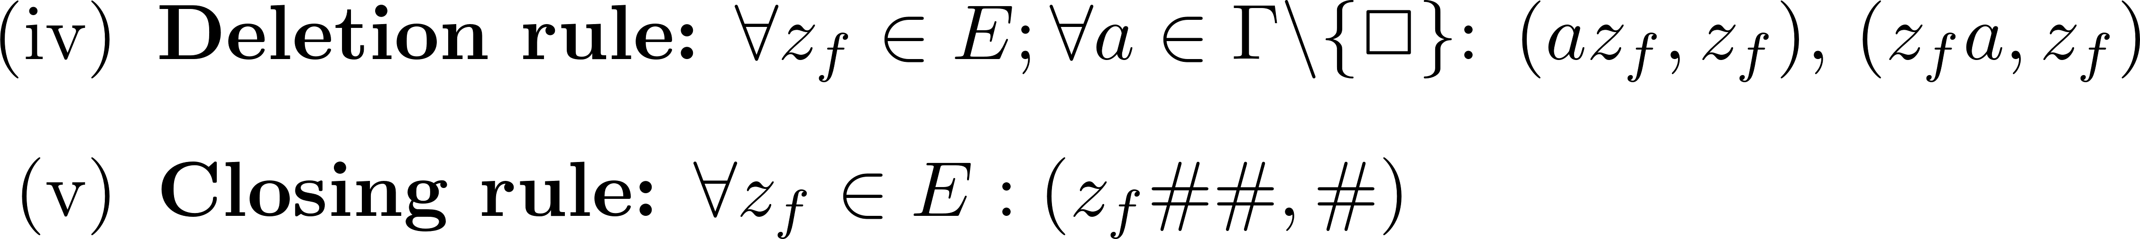
Mapping rules

Slide 25
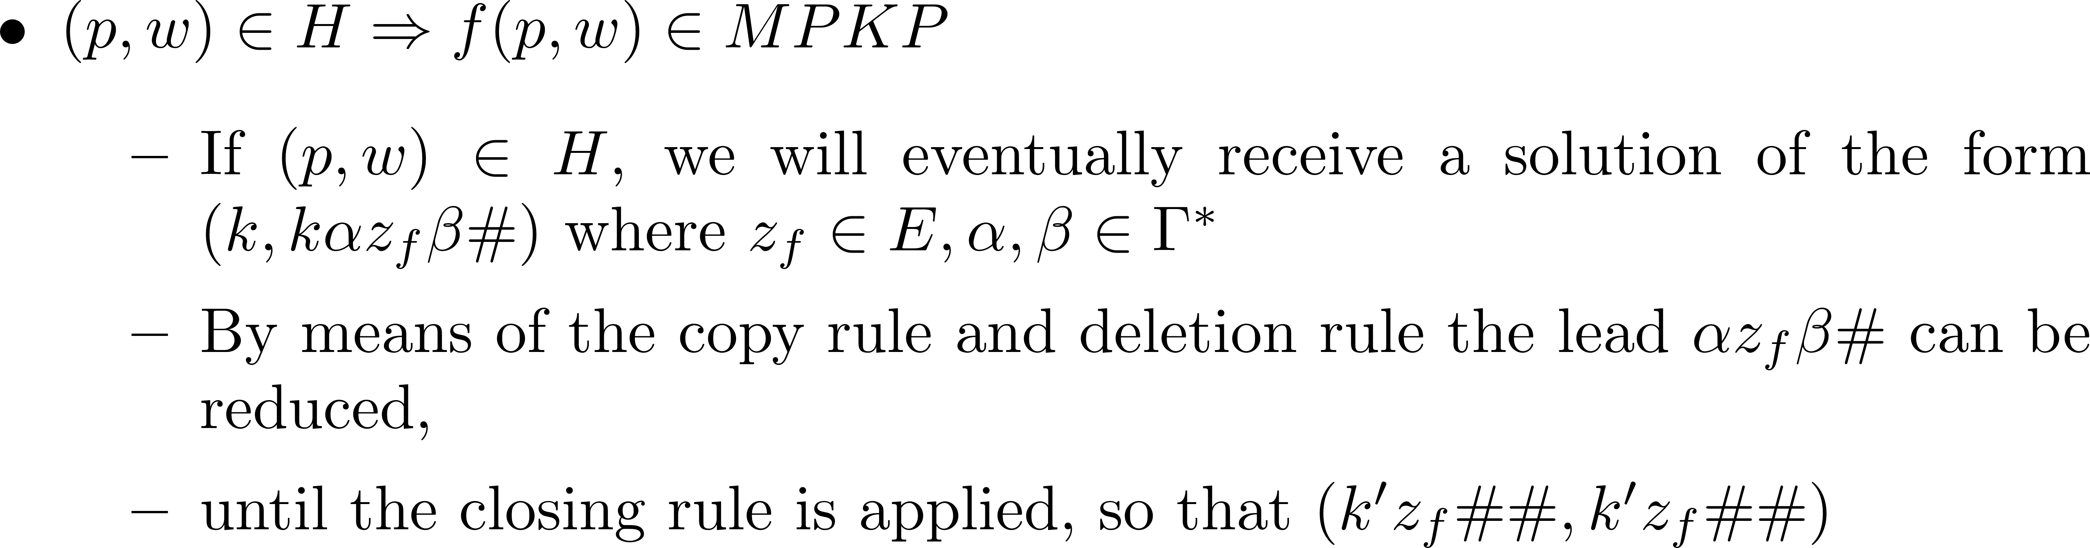
Proof of reduction theorem: „=>“

Slide 26
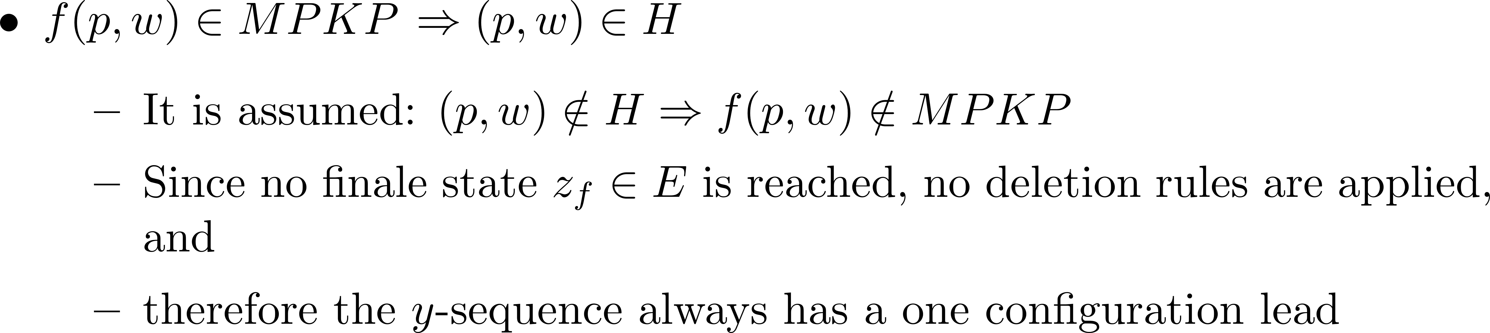
Proof of reduction theorem: „<=“

Slide 27
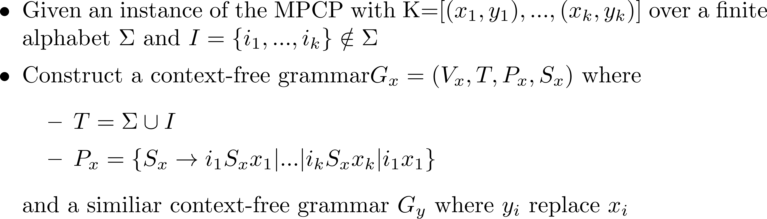

Theorem: Is $G$ ambiguous is undecidable

Slide 28
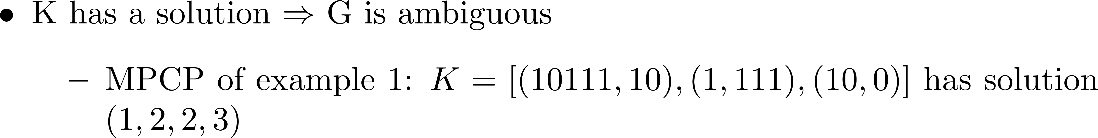
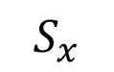
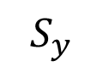
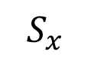
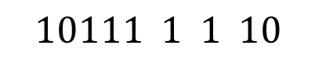
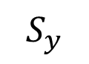
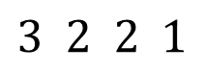
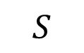
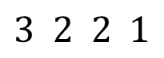
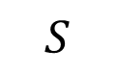
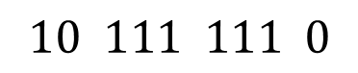
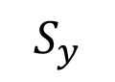
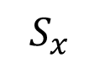
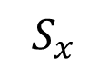
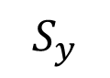
Theorem: Is $G$ ambiguous is undecidable
$$S$$
$$S$$
$$S_{x}$$
$$S_{y}$$
$$S_{x}$$
$$S_{y}$$
$$S_{x}$$
$$S_{y}$$
$$S_{x}$$
$$S_{y}$$
$$3 2 2 1$$
$$10111 1 1 10$$
$$3 2 2 1$$
$$10 111 111 0$$

Slide 29
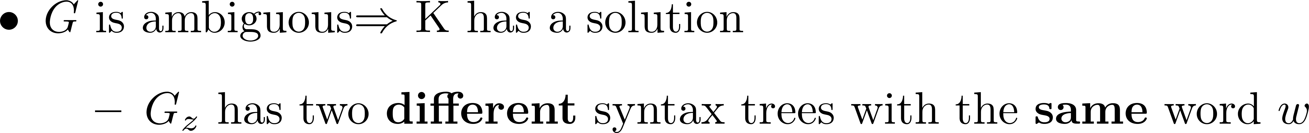
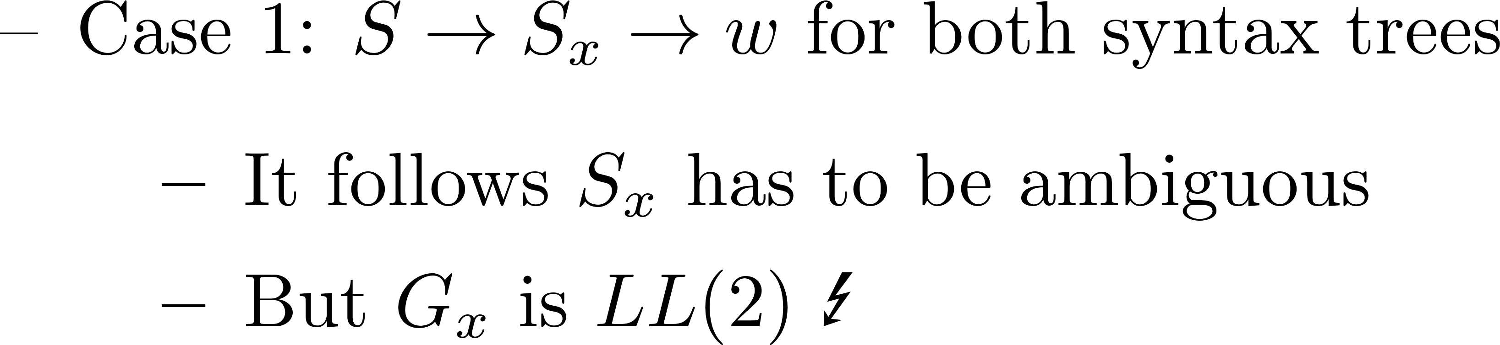

Theorem: Is $G$ ambiguous is undecidable

Slide 30






Theorem: $L\left(G_{1}\right)∩L\left(G_{2}\right)\overset{\text{?}}{=}∅$ is undecidable
$$S_{x}$$
$$S_{y}$$
$$w$$
$$w$$

Slide 31



Satz: |$L\left(G_{1}\right)∩L\left(G_{2}\right)|\overset{\text{?}}{=}∞$ ist unentscheidbar

Slide 33
Appendix

Slide 34

Theorem: PCP is undecidable

Slide 35



$$MPKP≤PKP$$

Slide 36

$$MPKP≤PKP$$

Slide 37

Exemplary Simulation: Construction 2
Rule tpye | Rule.Index | x-sequence | y-sequence | misc
Starting rule | (i).0 | $$\#$$ | $$\#z_{0}01\#$$
Copy rule | (ii).0 | $$0$$ | $$0$$
 | (ii).1 | $$1$$ | $$1$$
 | (ii).2 | $$\#$$ | $$\#$$
Transfer rule | (iii).0 | $$z_{1}0$$ | $$1z_{2}$$ | $$δ\left(z_{1},0\right)=(z_{2},1,R)$$
 | (iii).1 | $$0z_{1}1$$ | $$z_{2}00$$ | $$δ\left(z_{1},1\right)=(z_{2},0,L)$$
 | (iii).2 | $$1z_{1}1$$ | $$z_{2}10$$ | $$δ\left(z_{1},1\right)=(z_{2},0,L)$$
 | (iii).3 | $$0z_{1}\#$$ | $$z_{2}01\#$$ | $$δ\left(z_{1},⎕\right)=(z_{2},1,L)$$
 | (iii).4 | $$1z_{1}\#$$ | $$z_{2}11\#$$ | $$δ\left(z_{1},⎕\right)=(z_{2},1,L)$$
 | (iii).5 | $$0z_{2}0$$ | $$z_{f}00$$ | $$δ\left(z_{2},0\right)=(z_{f},0,L)$$
 | (iii).6 | $$1z_{2}0$$ | $$z_{f}10$$ | $$δ\left(z_{2},0\right)=(z_{f},0,L)$$
 | (iii).7 | $$z_{2}1$$ | $$0z_{1}$$ | $$δ\left(z_{2},1\right)=(z_{1},0,R)$$
 | (iii).8 | $$z_{2}\#$$ | $$0z_{2}\#$$ | $$δ\left(z_{2},⎕\right)=(z_{2},0,R)$$

Slide 38

Exemplary Simulation: Construction 2
Rule type | Rule.Index | x-sequence | y-sequence | misc
Deletion rule | (iv).0 | $$0z_{f}0$$ | $$z_{f}$$
 | (iv).1 | $$0z_{f}1$$ | $$z_{f}$$
 | (iv).2 | $$1z_{f}0$$ | $$z_{f}$$
 | (iv).3 | $$1z_{f}1$$ | $$z_{f}$$
 | (iv).4 | $$0z_{f}$$ | $$z_{f}$$
 | (iv).5 | $$1z_{f}$$ | $$z_{f}$$
 | (iv).6 | $$z_{f}0$$ | $$z_{f}$$
 | (iv).7 | $$z_{f}1$$ | $$z_{f}$$
Closing rule | (v).0 | $$z_{f}\#\#$$ | $$\#$$

Slide 39


Theorem: $L\left(G_{1}\right)⊆L\left(G_{2}\right)$ und $L\left(G_{1}\right)=L(G_{2})$, are undecideable

